Slide 1

Chapter 8 Search Engine Optimization
SEG301m

Slide 2
Objectives
What is search engine optimization?
How to implement search engine optimization?

Slide 3
Contents
8.1 Introduction to Search Engine Optimization (SEO)
8.2 Types of Search Engine Algorthims
8.3 Ranking Algorithms
8.4 On-Page SEO
8.5 Off-Page SEO
8.6 Technical SEO
8.7 Measuring SEO Performance

Slide 4
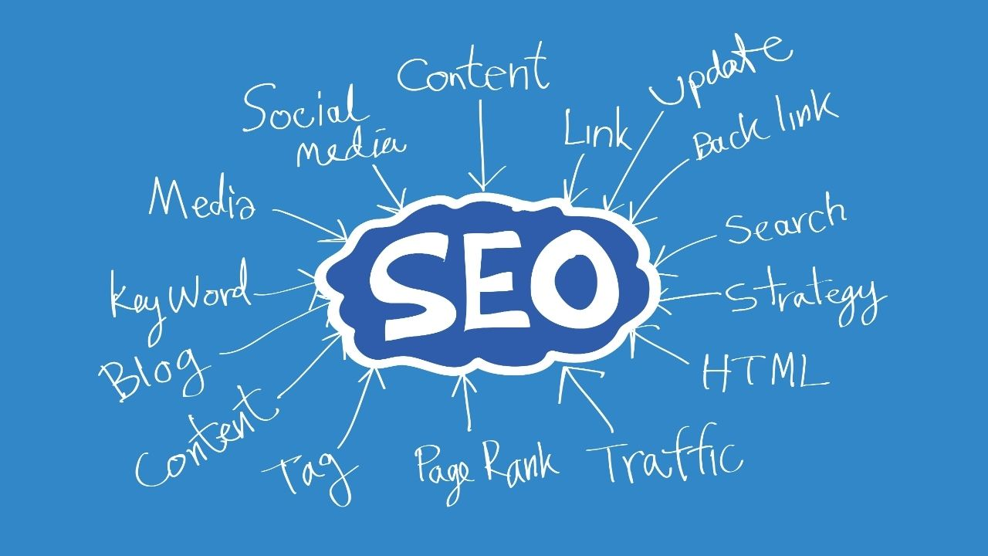
Introduction
Definition of SEO
SEO, or Search Engine Optimization, refers to the practice of optimizing a website, its content, and various online elements to improve its visibility and ranking on search engine results pages (SERPs).
The primary goal of SEO is to enhance a website's organic (non-paid) visibility on search engines like Google, Bing, and Yahoo, thereby increasing the likelihood of attracting relevant and valuable organic traffic.

Slide 5
Introduction
Improve Website's Visibility and Ranking on SERPs
The primary goal of SEO is to enhance a website's visibility and ranking on search engine results pages (SERPs). This involves various strategies and tactics, such as:
Keyword Optimization: Identifying relevant keywords and incorporating them naturally into the website's content, meta tags, and other elements.
On-Page Optimization: Making improvements to the website's structure, content, and HTML elements to make it more search engine-friendly.
Off-Page Optimization: Building high-quality backlinks from reputable websites to increase the website's authority and credibility.
Technical SEO: Ensuring that the website is accessible to search engine crawlers and addressing technical issues that might hinder indexing and ranking.

Slide 6
Types of Search Engine Algorthims
Search engine algorithms are complex sets of rules and calculations that search engines use to determine the order in which websites are displayed in search engine results pages (SERPs) in response to user queries.
These algorithms are designed to provide the most relevant and high-quality results to users based on various factors.
Search engines like Google, Bing, and Yahoo constantly update and refine their algorithms to improve the search experience for users.

Slide 7
Types of Search Engine Algorthims
Google
Google is the most widely used search engine, holding a significant share of the search market.
Its algorithm, including updates like Google Panda, Penguin, Hummingbird, and more, focuses on delivering relevant, high-quality results and penalizing spammy or manipulative practices.
Bing
Bing is Microsoft's search engine and is the second-largest search engine in terms of market share.
Its algorithm aims to provide diverse and visually appealing search results while prioritizing certain factors like social media integration.
Yahoo
While Yahoo has a smaller market share than Google and Bing, it still plays a role in the search landscape.
Yahoo's search algorithm is powered by Bing's search technology as part of a partnership between the two companies.

Slide 8
Ranking Algorithms
Let's create a simplified formulation of a ranking algorithm using a few key factors:
Ranking Score = (Weight1 * Factor1) + (Weight2 * Factor2) + ... + (WeightN * FactorN)
Ranking Score represents the calculated score for a web page's ranking.
Weight1, Weight2, ..., WeightN are the weights assigned to each factor.
Factor1, Factor2, ..., FactorN are the individual factors that contribute to the ranking

Slide 9
Ranking Algorithms
Explanation of Factors:
Relevance to Query (Factor1)
This factor assesses how well the content on a web page matches the user's search query.
The more relevant the content, the higher this factor will be.
Search engines analyze keyword usage and semantic context to determine relevance.
Quality and Authority (Factor2)
This factor evaluates the credibility and reputation of a web page.
High-quality, authoritative pages with valuable information receive a higher score.
Backlinks from reputable websites contribute to a page's authority.
User Engagement (Factor3)
User interaction metrics like click-through rate (CTR), bounce rate, and time spent on page reflect user satisfaction.
A page with higher user engagement metrics is considered more valuable.
Freshness (Factor4)
For time-sensitive queries, the freshness of content is crucial. Pages with recent updates or publication dates receive a boost in this factor.

Slide 10
Ranking Algorithms
Explanation of Factors:
User Experience (Factor5)
This factor considers technical aspects like page load speed, mobile responsiveness, and overall site usability.
Pages that offer a better user experience receive a higher score.
Semantic Understanding (Factor6)
Search engines use natural language processing to understand the context and intent behind a query.
This factor rewards pages that address the query's intent comprehensively.
Personalization (Factor7)
Personalized search results take into account user preferences, location, and search history to provide tailored results.
Backlink Profile (Factor8)
The number and quality of inbound links to a page influence its authority.
High-quality backlinks from relevant sources contribute positively to this factor.

Slide 11
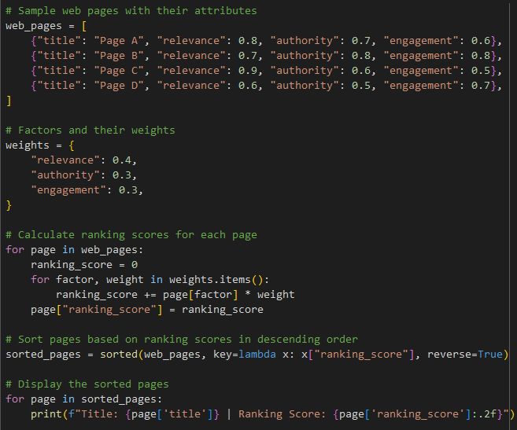

Ranking Algorithms
Example
In this example:
We'll create a list of web pages and assign scores to them based on a few factors.
We'll then sort the pages based on their scores to simulate the ranking process.
We define a list of web pages with attributes such as relevance, authority, and engagement.
We assign weights to these factors and calculate ranking scores for each page.
The pages are then sorted based on their ranking scores in descending order and displayed.

Slide 12
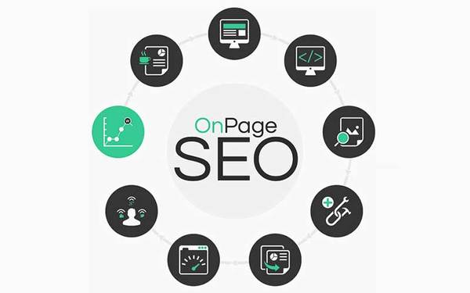
On-Page SEO
On-page SEO refers to the optimization of various elements within a webpage to improve its search engine visibility and enhance its relevance to specific keywords or topics.
These optimizations are done directly on the webpage itself, focusing on factors that are within the website owner's control.
On-page SEO plays a crucial role in helping search engines understand the content and purpose of a page, ultimately leading to better rankings in search engine results.

Slide 13
On-Page SEO
Optimization of Content, Keywords, Meta Tags, and Headers
Content Optimization: Create high-quality, valuable content that addresses the needs of your target audience. Use natural language and provide comprehensive information.
Keyword Optimization: Research and identify relevant keywords for your content. Place them naturally in the title, headings, and throughout the content.
Meta Tags: Optimize the meta title and meta description to include your target keywords. These are the snippets displayed in search results.
Headers (H1, H2, H3, etc.): Use headers to structure your content logically. The H1 tag should include the main topic or target keyword, while subheadings (H2, H3, etc.) should organize the content.

Slide 14
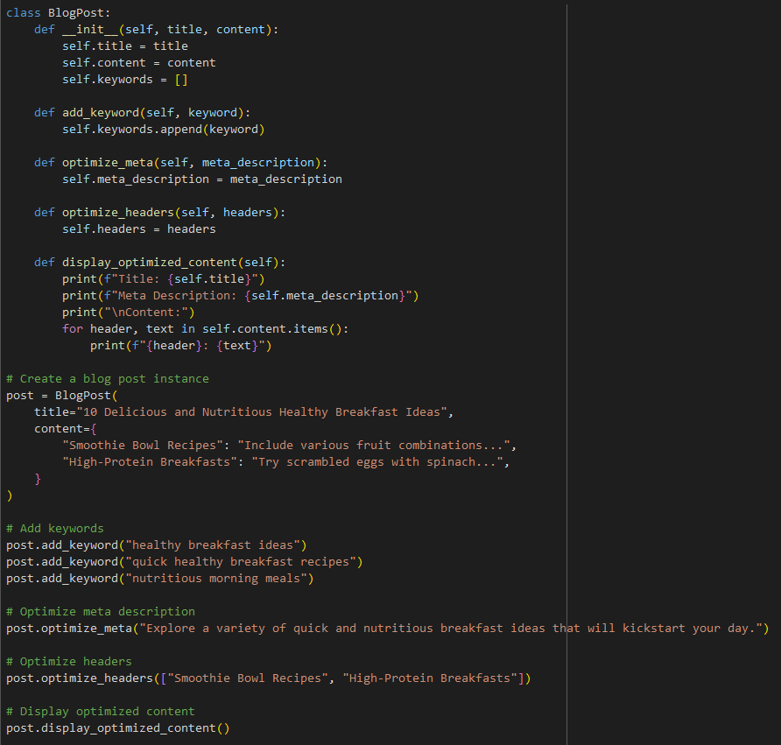
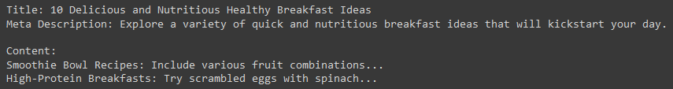
On-Page SEO
Example: Optimize a blog post for target keywords using on-page SEO techniques
Keyword Research: Identify related keywords, such as "quick healthy breakfast recipes," "nutritious morning meals," etc.
Meta Description: Write a compelling meta description that summarizes the content and includes the target keyword: "Explore a variety of quick and nutritious breakfast ideas that will kickstart your day. From smoothie bowls to whole-grain options."
Content: Develop detailed content that provides recipes, nutritional information, and preparation tips for each breakfast idea. Naturally include variations of your target keywords throughout the content.

Slide 15
Off-Page SEO
Off-page SEO refers to all the activities that are done outside of your own website to improve its search engine rankings and overall online reputation.
Unlike on-page SEO that focuses on optimizing elements within your website, off-page SEO involves strategies that are conducted on other websites and platforms.
The primary goal of off-page SEO is to enhance your website's authority, credibility, and popularity in the eyes of search engines and users.

Slide 16
Off-Page SEO
Importance of Backlinks and Their Quality.
Authority and Trust
Search engines view backlinks as endorsements. If reputable websites link to your content, it signals that your content is valuable and trustworthy.
Search Engine Rankings
Backlinks are one of the most important ranking factors in search engine algorithms. Pages with high-quality backlinks tend to rank higher in search results.
Referral Traffic
Backlinks can bring direct traffic to your website from visitors who click on the link. These visitors are likely to be interested in your content or offerings.
Indexing and Crawling
Backlinks help search engine crawlers discover new pages and index them faster, increasing your website's visibility.
Building Authority
A strong backlink profile helps establish your website as an authority in your niche or industry.

Slide 17
Technical SEO
Technical SEO refers to the optimization of a website's technical aspects to improve its search engine visibility and crawlability.
It involves making enhancements that facilitate search engines' ability to access, understand, and index your website's content.
Technical SEO focuses on technical elements that affect how search engines interact with your site, ensuring that it meets the requirements for optimal indexing and ranking.

Slide 18
Technical SEO
Importance of Website Structure, Speed, and Mobile-Friendliness
Website Structure: A well-organized website structure with clear navigation helps both users and search engines find content easily. A logical hierarchy and proper internal linking can lead to better indexation and user experience.
Page Speed: Faster-loading pages provide a better user experience and can positively impact search rankings. Google considers page speed as a ranking factor and users tend to abandon slow websites.
Mobile-Friendliness: With a significant portion of web traffic coming from mobile devices, having a responsive design that offers a seamless experience across various screen sizes is crucial. Mobile-friendly sites often rank better in mobile search results.

Slide 19
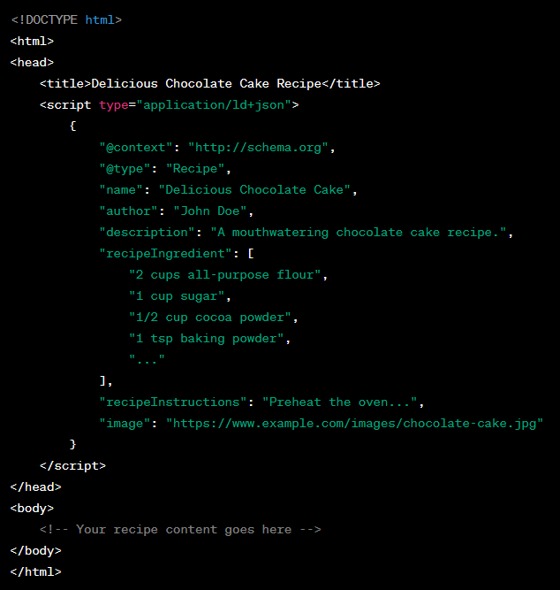
Technical SEO
Example: Implementing Schema Markup for Rich Snippets
Schema markup is a type of microdata that you can add to your HTML code to provide additional context about your content to search engines.It helps search engines understand the content on your website better and can lead to rich snippets in search results.
In this example:
We've used JSON-LD (JavaScript Object Notation for Linked Data) to add schema markup for a recipe.
The structured data provides details about the recipe's name, author, ingredients, instructions, and an image.
When search engines encounter this markup, they can display rich snippets in search results, showing additional information like the recipe's image, rating, and cooking time.
This enhanced presentation can attract more clicks and improve the visibility of your content.

Slide 20
Measuring SEO Performance
Tracking and analyzing SEO efforts are essential for several reasons
Measuring Progress: Tracking allows you to see how your SEO efforts are performing over time, helping you gauge whether your strategies are effective or need adjustments.
Identifying Successes and Failures: Analysis helps you understand what's working well and what's not, allowing you to replicate successful strategies and correct ineffective ones.
Data-Driven Decision Making: Instead of relying on assumptions, tracking provides concrete data to base your decisions on, leading to more informed and strategic choices.
Optimization Opportunities: Analyzing data helps you identify areas where you can optimize further for better results.
Resource Allocation: By knowing which strategies are delivering the best results, you can allocate resources more effectively to achieve higher ROI.

Slide 21
Measuring SEO Performance
Metrics: Organic Traffic, Keyword Rankings, Click-Through Rates (CTRs)
Organic Traffic
This metric measures the number of visitors who land on your website through organic (non-paid) search results. Increasing organic traffic indicates your site's growing visibility.
Keyword Rankings
Tracking keyword rankings helps you see where your website stands in search results for specific keywords. Improvements in rankings suggest your content is becoming more relevant.
Click-Through Rates (CTRs)
CTRs show the percentage of users who click on your website's link in search results after seeing it. High CTRs indicate that your title and meta description are engaging and relevant.

Slide 22
Measuring SEO Performance
Tools: Google Analytics, Google Search Console, Third-Party SEO Tools
Google Analytics
Offers comprehensive insights into your website's traffic sources, user behavior, and engagement. You can track organic traffic, user demographics, pages visited, and more.
Google Search Console
Provides data about how Google's search engine interacts with your site. It offers information about keyword rankings, click-through rates, and any issues affecting your site's visibility.
Third-Party SEO Tools
Tools like Ahrefs, SEMrush, Moz, and others offer in-depth analyses of keywords, backlinks, site health, and more. These tools can provide competitive insights and help identify optimization opportunities.

Slide 23
Practice
Assignment Description
In this assignment, you will use the Google Analytics API and the google-analytics-api-python library to fetch and analyze website data related to SEO metrics.
You will be retrieving organic traffic, top landing pages, and top referring sources using Python.

Slide 24
Practice
Setup
Make sure you have a Google Analytics account and have set up an API project in the Google Cloud Console.
Install the required library using: pip install google-analytics-api-python
Tasks:
Fetch Organic Traffic
Fetch the total organic traffic for the last 7 days for your website using the Google Analytics API. Print the total organic sessions.
Top Landing Pages
Fetch the top 5 landing pages (pages where users enter your site) for organic traffic over the last 30 days. Print the page titles and the number of sessions.
Top Referring Sources
Fetch the top 5 referring sources (websites that send traffic to your site) for organic traffic over the last 30 days. Print the source names and the number of sessions.

Slide 25
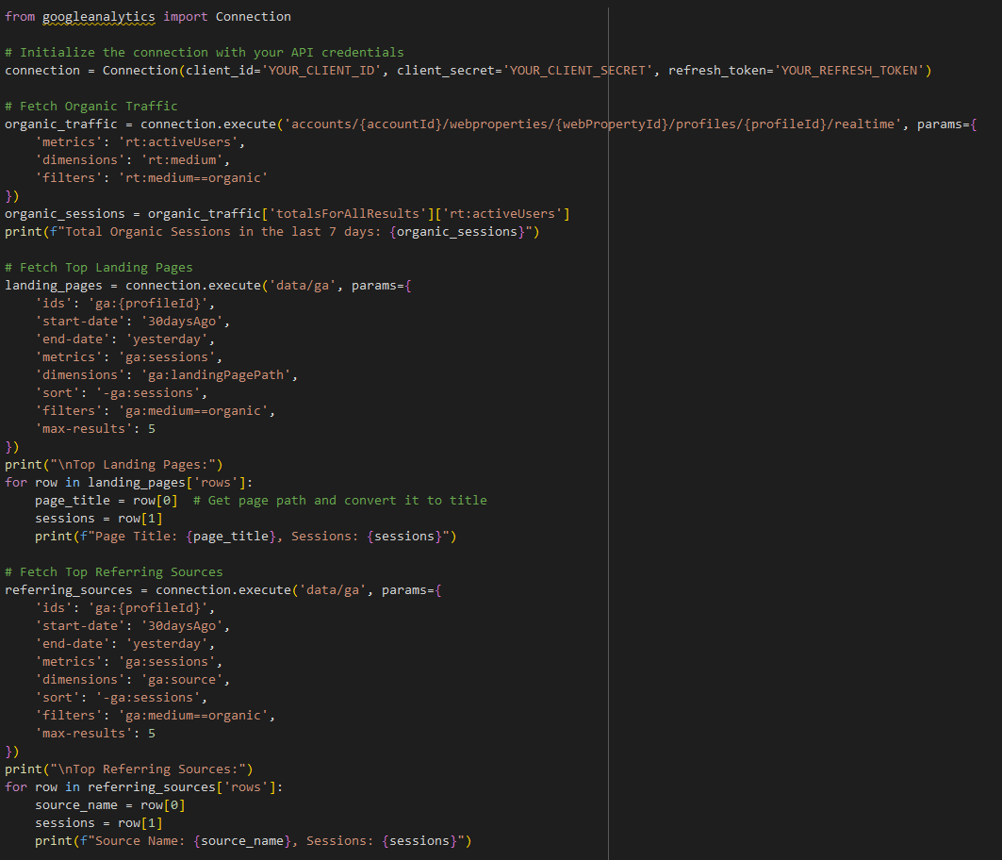
Solution
Replace 'YOUR_CLIENT_ID', 'YOUR_CLIENT_SECRET', and 'YOUR_REFRESH_TOKEN' with your actual API credentials

Slide 26
Summary
Introduction to Search Engine Optimization (SEO)
Types of Search Engine Algorthims
Ranking Algorithms
On-Page SEO, Off-Page SEO
Technical SEO
Measuring SEO Performance

